Slide 1






90min
Micro
Services
Theoretical
Introduction
ArchitectureTrack

Slide 2




Menu
The Monolith
MicroServices
Interprocess Communication
Business Logic
Queries
External APIs
Production Ready
Deployment

Slide 3




Microservices Patterns
Tis een halve boekbespreking
With examples in Java
470 pages on everything MicroServices
By Chris Richardson: microservices.io
Describes a collection of Patterns

Slide 4


Chapters
The Monolith
Interprocess Communication
Transactions
Business Logic
Queries
External APIs
Testing
Deployment
Decomposition & Refactoring

Slide 5

Microservices Patterns
Design Patterns… Again?
FORCES
What we must address
RESULTING CONTEXT
Benefits – what did we gain
Drawbacks – what did we lose
Issues – new problems we introduced
FOR
Application And Infrastructure

Slide 6


Monolithic Architecture
For example n-tier or Hexagonal
Why you should build a Monolith
It’s easy – your IDE handles it well
It’s easy – everyone has experience creating one
It’s easy – to write unit & integration tests
It’s easy – to deploy
It’s easy – to scale (typically)
It’s easy – to make big changes
Typically a good top level architecture to start with

Slide 7

Monolith vs Success
If your application is very successful, the monolith may turn out to be not such a great idea after all
Notes:
The team grew, the codebase grew, the product grew

Slide 8

Monolithic Hell
The codebase intimidates developers
Development is slow
Edit-build-run-test loop takes a long time
The road to deploy is long and arduous
Locked in an increasingly obsolete stack

Slide 9
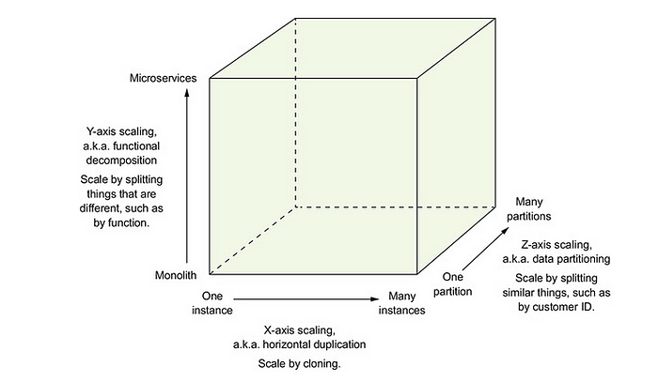
The Scale Cube
Scaling may turn out to be not that easy (anymore)

Slide 10

Monolithic Hell
Maintainability, extensibility and testability suffer

Slide 11


So… MicroServices?
Each service is small and easily maintained
Can be independently deployed
Can be independently scaled
Teams can work autonomously
Better fault isolation
Easy experimentation and adoption of new technologies
Notes:
Each service can be X & Z scaled

Slide 12
4+1 View Model
Implementation View:
Monolith: a single exe
MicroServices: multiple exes
Logical View:
Both are layered or hexagonal

Slide 13
Reverse Conway Maneuver
Organizations which design systems … are constrained to produce designs which are copies of the communication structures of these organizations
-- Melvin Conway
Notes:
https://en.wikipedia.org/wiki/Conway%27s_law
https://www.thoughtworks.com/insights/blog/customer-experience/inverse-conway-maneuver-product-development-teams

Slide 14

How Micro is a MicroService?
The size of a MicroService is not relevant
A team could be responsible for a single MicroService
So maybe it’s not “Micro” at all!
What is important
Minimal lead time
Minimal collaboration with other teams
Notes:
Lead time: from request to deployment

Slide 15

No Silver Bullet
There are significant drawbacks & challenges
Finding the right services is challenging
Distributed systems are complex
Other services are down or unavailable
Deployment needs coordination
Writing tests spanning multiple services
Additional operational complexity
What about cross-cutting concerns
Notes:
Complexity:
What to do when the other system is down, unavailable or crashes?

Slide 16
No Silver Bullet
There are significant drawbacks & challenges
If you need to collaborate with different teams for the smallest of changes
If you constantly need to make changes because of changes in other services
You have just built yourself a distributed monolith
All of the drawbacks
None of the benefits

Slide 17

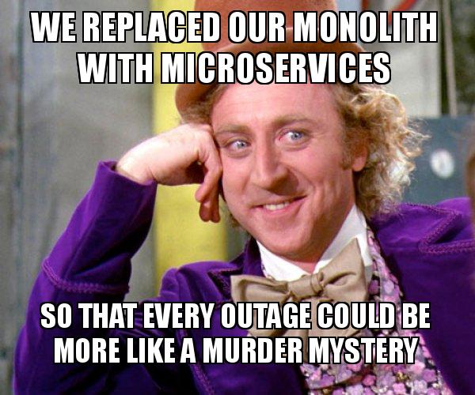

Slide 18

Loosely Coupled Services
Communication via APIs or Messaging
Internals are hidden
Each service has its own database
✅ Can change independently
✅ No locks by other services
⚠️ Queries are harder
⚠️ Maintaining data consistency
Notes:
Internals are hidden: Information Hiding / Encapsulation at a higher level

Slide 19

Obstacles
Network latency & chatty services
Batch calls or combine services?
Synchronous Interprocess Communication
Reduces availability
Maintain data consistency
Distributed Transactions vs Saga
Consistent view of data
Letting go of the monolithic ACID
Notes:
Chatty Services:
To get Order + Consumer => 2 calls
OR: /v1/order/5?expand=consumer => 1 call (less chatty) → or use GraphQL
Synchronous Interprocess Communication:
Reduced availability: if one service is down, you are down
Synchronous API call? → Because you are waiting for it!
ACID: Atomic, Consistent, Isolated, Durable
MicroServices only has ACD

Slide 20

Interprocess Communication
Monolith: in process calls (<1ms)
MicroServices: interprocess (10-500ms)
Synchronous: REST (JSON/XML), gRPC
Async: AMQP, STOMP
Allows one-to-many
Binary vs Human Readable
Verbosity: cost, longer parsing, performance
Notes:
Interprocess: network latency, de(serialization) and server processing + potential packet loss/retries & network congestion
gRPC: Google Remote Procedure Call
AMQP: Advanced Message Queuing Protocol
STOMP: Simple (or Streaming) Text Oriented Messaging Protocol
One-to-many: with publish/subscribe

Slide 21
Interprocess Communication
Defining APIs
New incompatible version deployed becomes a runtime exception rather than a compilation error
Need for IDL: Interface Definition Language
Need for a strategy to evolve APIs
Can’t force other teams to upgrade (immediately)
Run versions side-by-side – no lockstep upgrades needed
Semantic versioning
Robustness Principle
Notes:
IDL: OpenApi Specification (from Swagger)
Semantic Version: Major.Minor.Patch
Often done: putting the major version in the url
Put major in header,MIME type, …
Robustness Principle
Be conservative in what you do, be liberal in what you accept
Provide defaults for new request properties (that conserve the initial behavior)
Ignore new response properties

Slide 22
Interprocess Communication
Defining APIs
Pattern: Proxy & Adapter
Hide that it is a Remote Procedure Invocation
Hide the address, port and protocol used
Notes:
REST levels:
Level 2: GET, POST, PUT and Resources
Level 3: HATEOS: GET returns urls for operations

Slide 23

Interprocess Communication
Circuit Breaker
A proxy that rejects invocations
for x time after y consecutive failures
Network timeouts
Limit outstanding requests to server
Exceeded threshold → Fail immediately
Notes:
Circuit Breakers: Netflix Hystrix, Polly

Slide 24
Interprocess Communication
Failure Recovery
Essential → Fail
Return a default value
Return a cached response
Decide on a case per case basis…
Notes:
Default Value: if it’s not that important
Cached Response: if stale data is ok
The client or frontend can maybe still work with partial data.

Slide 25
Interprocess Communication
Service Discovery
What is the URL
Monolith: a config file
MicroService: cloud and/or dynamic
Notes:
Dynamic URL:
Auto-Scaling
Failures → and auto-restarts
(Rolling) Upgrades

Slide 26
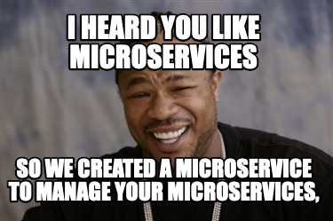
Interprocess Communication
Service Discovery
The solution, as so many times with MicroServices,
is to… add another service
“Service Registry”

Slide 27
Interprocess Communication
Service Registry
Self-Registration
A service registers itself + health check & heartbeat
Client-Side Discovery
Query the Service Registry + cache
+ Load balancing
Prefer a platform-provided solution
Notes:
Example: Netflix Eureka + Ribbon Http client, Pivotal Spring Cloud
Platform provided: Docker & Kubernetes → The deployment system handles it

Slide 28

Interprocess Communication
Asynchronous Messaging
Message Broker
The intermediary between services
Another service 😉
Exchange messages over a channel
Types of messages
Document: receiver interprets
Command: point-to-point
Event: publish/subscribe
Notes:
ActiveMQ, RabbitMQ, Kafka, AWS Kinesis, AWS SQS
Events or Broadcasts

Slide 29

Interprocess Communication
Asynchronous Messaging
Brokerless Messaging:
✅Broker is not the bottleneck or single point of failure
✅More lightweight
⚠️Tighter coupling between services
⚠️Reduced availability
⚠️Guaranteed delivery is trickier
Notes:
Brokerless: (ex: ZeroMQ)
Send messages directly from server to receiver
Reduced availability: both sender and receiver need to be available

Slide 30
Interprocess Communication
Asynchronous Messaging
Competing Message Broker Capabilities
Language support
Ordered delivery vs Latency
Persistence: survive a system crash
Durability: receive missed messages after service restart
Competing consumers
Guaranteed delivery: deliver at least once
Notes:
Competing capabilities: pick a broker that supports what you need
Ordered delivery typically means increased latency
Guaranteed delivery: Typically a broker promises to deliver a message at least once (receive, handle, crash before acknowledging handled)

Slide 31
Interprocess Communication
Asynchronous Messaging
Deliver AT LEAST ONCE? 😱😱😱
Write idempotent message handlers
Track messages and discard duplicates
Pattern: Transactional Outbox
Save the message id in an outbox table and commit this as part of the database transaction
Send the message by polling the outbox
Or by log tailing the database transaction log
Notes:
Database Transaction Log Tailing:
Debezium (Kafka), LinkedIn Databus, DynamoDB Streams, Eventuate Tram

Slide 32
Interprocess Communication
Asynchronous Messaging
Try to eliminate synchronous interactions
Send a message and return a response immediately
Replicate data instead of querying
Use a Saga
Notes:
Replicate data:
By subscribing to changed events. CQRS covered later on.

Slide 33

Interprocess Communication
Asynchronous Messaging
Saga: a message driven sequence of local transactions in order to maintain data consistency
Countermeasures for missing Isolation
Choreography vs Orchestration
Notes:
Countermeasures:
Implement countermeasures to prevent or reduce impact of concurrency anomalies
Choreography:
Participants of the saga exchange messages without central point of control
Orchestration:
Centralized controller tells participants what to do

Slide 34
Interprocess Communication
Asynchronous Messaging
Saga alternative: Distributed Transaction
X/Open XA: Two-phase commit (2PC)
All participants commit or rollback
✅ No data consistency anomalies
⚠️ We’re basically synchronous again
⚠️ Reduced availability
⚠️ Not supported by MongoDb, RabbitMQ, Kafka
Notes:
Basically an Anti-Pattern
Data consistency anomalies:
Lost updates: overwrite something from another saga
Dirty reads: read half finished saga
Non-repeatable reads: two steps of the saga see something different
Reduced availability: all participants must be available!

Slide 35

Interprocess Communication
Asynchronous Messaging
Saga: each service commits
We need compensating messages
Compensatable Transactions
Pivot Transactions
Retriable Transactions
Notes:
For when things go wrong…
Compensatable Transactions:
Transactions that can be rolled back by compensating transactions
Pivot Transactions:
The go/no-go point of the sage (ex: payment)
Retriable Transactions:
After the pivot transaction, if one of these fails, we will try them again

Slide 36

Interprocess Communication
Asynchronous Messaging
Saga: Choreography
Service handles and sends the next message
Must use “Transactional Outbox”!
Correlation ID for event mapping

Slide 37
Interprocess Communication
Asynchronous Messaging
Saga: Choreography
✅ Loosely coupled & Simple
⚠️ Flow is defined in multiple places
⚠️ What has (already) happened?
⚠️ Risk of tight coupling

Slide 38

Interprocess Communication
Asynchronous Messaging
Saga: Orchestration
Orchestrator is a State Machine
Orchestrator sequences between states and not contain any logic
✅ Easy to test
✅ Recommended

Slide 39

Business Logic
Transaction Script
Domain Model
EventSourcing
Notes:
Transaction Script:
If it’s simple, keep it simple.
Domain Model:
Aggregates map to Services.
Also here challenges: what does it mean to delete an entity? (Fuzzy Boundaries)
→ We’ll have DDD sessions 😀
EventSourcing:
A developer might forget to send an EntityUpdated event after processing his BL → Use EventSourcing to update aggregates instead!
→ See our CQRS session!

Slide 40

Business Logic
Domain Events
EntityUpdated events
Noteworthy changes on aggregates
Notify for the next step in the process
Send notifications (email, SMS, …)
Analyze events for user behavior

Slide 41
Business Logic
Domain Events
EntityUpdated events
ID Only
✅ Small messages
⚠️ Consumers need to request
Enrichment
⚠️ Less stable events

Slide 42

Break

Slide 43
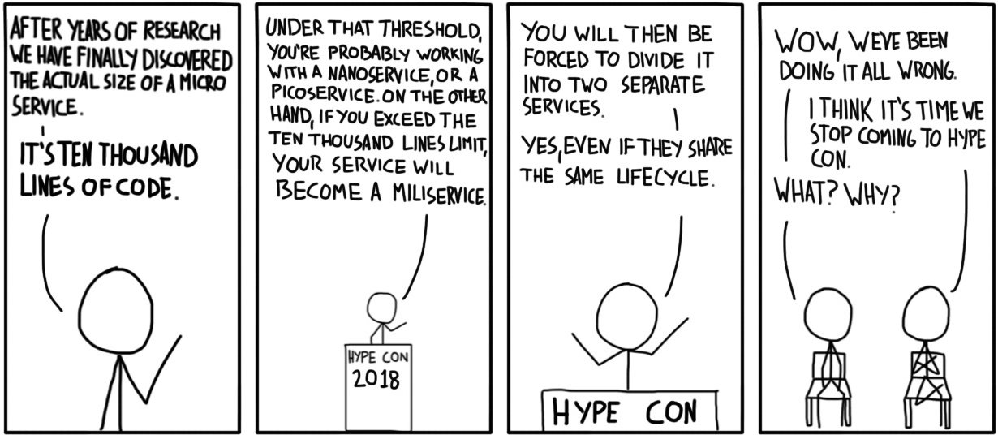
How Micro is a MicroService?
Notes:
Lead time: from request to deployment

Slide 44

Queries
Pattern: API Composition
Query multiple services and combine the results
✅ Easy to implement
⚠️ Network and computing overhead
⚠️ Lack of transactional data consistency
⚠️ Reduced availability
Cached fallbacks
Return incomplete data

Slide 45

Queries
Pattern: CQRS
Maintain read-only Elastic/Solr for complex queries
Might be inefficient to select everything
Too much data
Join large datasets in memory
Notes:
Example:
Restaurant app & database does nor support geospatial datatypes (findAvailableRestaurants)

Slide 46

External APIs
Internal & External Clients
Don’t expose the microservices
Difficult to use, bad dev xp
Difficult to force upgrades of 3rd parties
Solution: API Gateway
Notes:
Internal Admin App: High bandwidth LAN
External Clients: Lower performing internet

Slide 47
External APIs
API Gateway
API Composition
Authentication & other edge functions
Routing
Protocol Translation
One-size-fits-all or data depends on client
Pattern: Backends for Frontends
Notes:
Edge functions:
Authentication, Authorization, Rate limiting, Caching, Metrics collection, Request logging
Protocol translation: Internal service might use gRPC
Depends on client: return less data for a mobile client
Backends for frontends: Netflix Falcor

Slide 48
External APIs
API Gateway
Handle partial failures
Uses Service Discovery Patterns
Potential bottleneck
Off the shelf or GraphQL
Notes:
Off the shelf: Netflix Zuul, Traefik, Spring Cloud Gateway, AWS API Gateway, AWS Application Load Balancer

Slide 49

Production Ready
Developing production-ready Services
Security
Configurability
Observability

Slide 50

Production Ready
Security
Authentication & Authorization
Auditing
Secure Communication (TLS)
Access Token (by API Gateway)
JWT or Oauth 2.0
Notes:
Spring Security, Apache Shino, NodeJS Passport

Slide 51

Production Ready
Configurability
Externalized Configuration
Push Model CI passes configuration to the service
Pull Model Service reads config from a service
Notes:
Push: using environment variables or files. Files: there are files everywhere.
Pull: using git, a DB, Spring Cloud Config
Sensitive data: Hashicorp Vault, AWS Parameter Store
Pull is centralized, dynamic reconfiguration, transparent decryption, yet another service

Slide 52

Production Ready
Observability
Healthchecks
Simple 200/500
Or more detailed
Watch out for oversharing
Used by the deployment infrastructure
Notes:
Ex: HealthChecks.NET, Spring Boot Actuator
Checked by: Docker, Kubernetes, Netflix Eureka
More detailed:
Do a db query
Check external services are available

Slide 53

Production Ready
Observability
Log Aggregation
Elastic, Splunk, DataDog, …
Distributed Tracing
Log a request ID!
Application Metrics
CPU, memory, disk utilization
Exception Tracking & Alerting
Notes:
You don’t want to go checking log files on different servers
Application Metrics: Heartbeats & Prometheus
Exception Tracking: de-duplicate exceptions. Alerting with for example Sentry.IO

Slide 54
Production Ready
Observability
Audit Logging
Customer Support
Ensure Compliance
Detect suspicious behavior
“Easy” with EventSourcing

Slide 55

Circuit Breaker, Tracing, Logging, Service Discovery, Health checks, Configuration, …

Slide 56

Production Ready
Pattern: MicroService Chassis
Combine all cross-cutting concerns
Pattern: Service Mesh
Route all traffic through a layer that does the chassis stuff + load balancing, routing, …
Notes:
Chassis: GoKit, Micro
Mesh: Istio, Conduit, Linkerd

Slide 57

Deployment
It needs to be highly automated
Deploying a million services manually is not feasible
DevOps Teams
Pets vs Cattle
Snowflake vs Phoenix

Slide 58
Deployment
Language-Specific Package Pattern
Copy the code & start
✅ Easy & fast
✅ Good way to get started
⚠️ Different versions of .NET / SDK 😬
⚠️ Service crashes on same machine can impact others
⚠️ A service can utilize all CPU
⚠️ Manually decide on what machines to put which services

Slide 59
Deployment
A Virtual Machine (VM)
Ship the whole thing: OS, Dependencies & App
✅ Got everything & the right versions too!
✅ Fixed amount of CPU & memory
⚠️ Overhead of an entire OS
⚠️ Slower: need to send a lot of bytes
⚠️ Must maintain the machines (patches & updates)
⚠️ Might be paying for lots of unused resources
Notes:
Elastic Beanstalk, Packer for VirtualBox, VMWare, Aminator, …

Slide 60
Deployment
A Container Image
Build image, push to registry, start container
✅ Isolated
✅ Can specify CPU & Memory
✅ More lightweight than a VM
⚠️ You’re responsible for the Image administration
Notes:
Ex: Docker, Podman
Registry: Docker Cloud Registry, AWS EC2 Container Registry

Slide 61
Deployment
Kubernetes
Docker Orchestration: uses a set of machines with Docker as a pool of resources as if it were a single machine.
Service Management: named & versioned services
Zero downtime deployments: rolling updates / rollbacks
Have x healthy instances of a service (health checks)
Load balancing
Scheduling: Checks service requirements to select a machine
(Anti)-Affinity: services to (not) run on the same machine
Notes:
Service Mesh: Separate deployment from release
Deploy, test and only then release
Maybe next Architecture/Cloud sessions on Kubernetes…

Slide 62
Deployment
Serverless
✅ Only pay for what you use
✅ Eliminate sysadmin tasks
✅ Elasticity: spin up as needed to handle the load
⚠️ Cold startup
⚠️ Not intended for long running processes
Notes:
AWS Lambda, Azure Functions
Long running processes: don’t put a message handler on serverless

Slide 63

Refactoring
When to move to MicroServices
Don’t!
Slow Delivery & Deployment? → Automated testing!
Poor Scalability? → Scale Cube!
→ First try simpler solutions!

Slide 64

Refactoring
When to move to MicroServices
If you find yourself in a hole, stop digging

Slide 65
Refactoring
Moving to MicroServices
Strangle the monolith
Don’t attempt a rewrite
Migrate high value areas
These can then evolve independently
You don’t need all the MicroService infrastructure (right away)
Notes:
Rewrite:
Moving target
Or no more delivery for a long time
High value areas:
Can demo benefit to the business quickly
Extract a service on an area that is actively being developer

Slide 66
Refactoring
Moving to MicroServices
Split the UI
Splitting the domain
Potentially major surgery
Hexagonal: limit changes to in/out adapters
Database Refactorings
Move data
Replicate with triggers
Notes:
Move data: to the new services
Replicate: and make the monolith data read-only
Or: Write new features as services
Or: Focus o
Timebox service architectures.

Slide 67
Refactoring
Moving to MicroServices
Minimize changes to the monolith
API Gateway
Integration Glue Code
Anti-Corruption Layer
Notes:
API Gateway: Route to monolith or a MicroService
Glue Code: Messaging or Invoke REST APIs from the Monolith

Slide 68
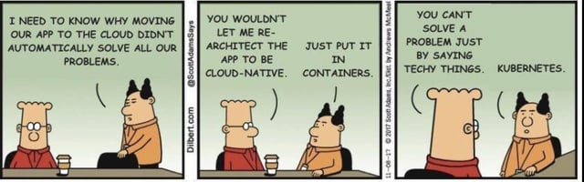
The End

Slide 69
Questions?

Slide 70
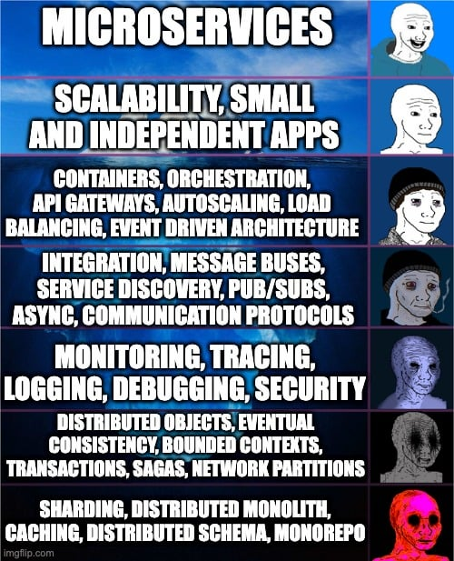
Menu
Thing 1
Notes:
https://github.com/as-a-service/meme

Slide 71








Our Socials
@itenium
@itenium_be
itenium
itenium-be
itenium.be
@itenium
itenium.be

Slide 72



WiFi: ITENIUM_GAST / FreeWifi

Slide 73



THANK YOU!

